Slide 33
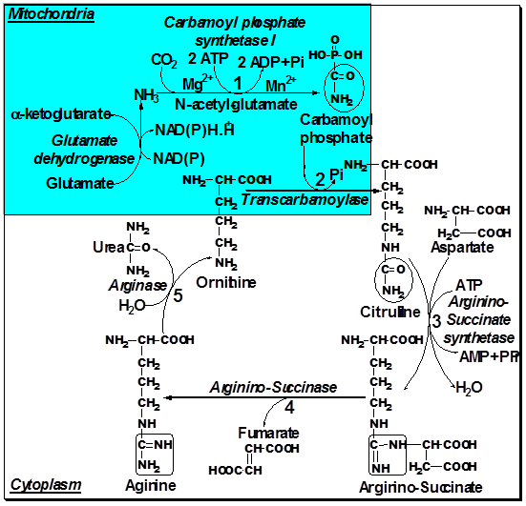

Slide 34
thanks

